Slide 1

Identifying a suitable location to open a restaurant in Toronto By Cesar

Slide 2
Business Problem
In this project, I identify selected neighborhoods in Toronto where a person can open a restaurant. The selection of the neighborhoods depends on the requirements of the person/client. The client’s requirements are:
Location must be a safe place where breaking and entering crimes are low.
There should be a few or no restaurants in a 500-meter radius from location.
There should be commercial buildings/offices nearby where employees go to work.
Location must be near parks. Client likes parks and think people will gather there and eventually eat at his restaurant.

Slide 3
Data
Reports found on Toronto Police Website http://data.torontopolice.on.ca/pages/open-data
Commercial Venues data found on https://developer.foursquare.com/

Slide 4
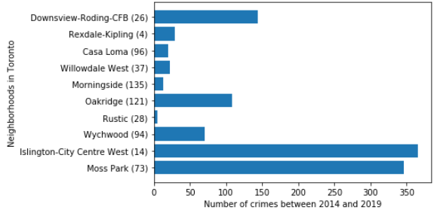
Exploring Data
Number of crimes of some neighborhoods in Toronto from 2014 to 2019

Slide 5
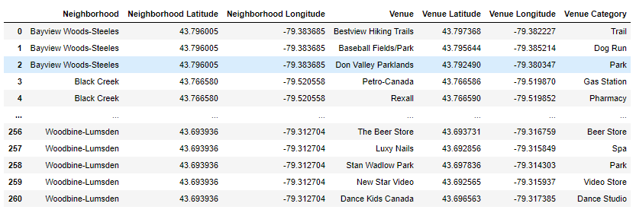
Exploring Data
Table contains venues located within 500-meter radius of each neighborhood coordinates.

Slide 6
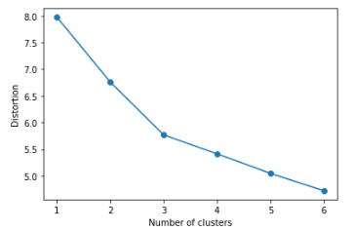
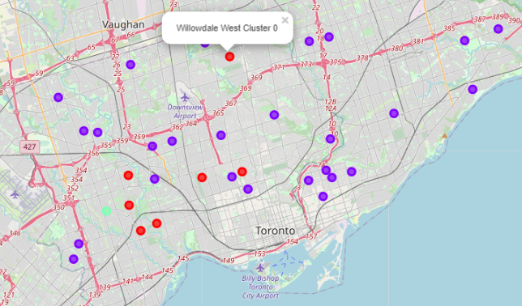
Analyzing Data
Elbow method to determine k-means number of clusters
Map contains the location of 3 clusters

Slide 7
Analyzing Data
Map contains the location of 3 clusters

Slide 8
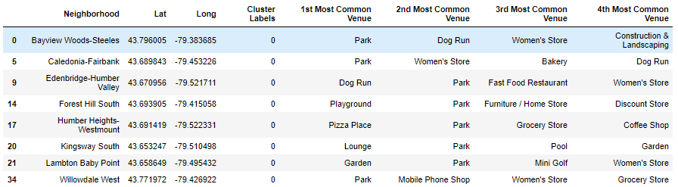
Analyzing Data
Table contains information about cluster 0

Slide 9
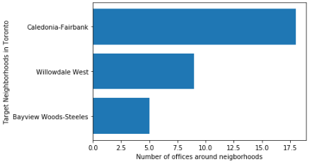
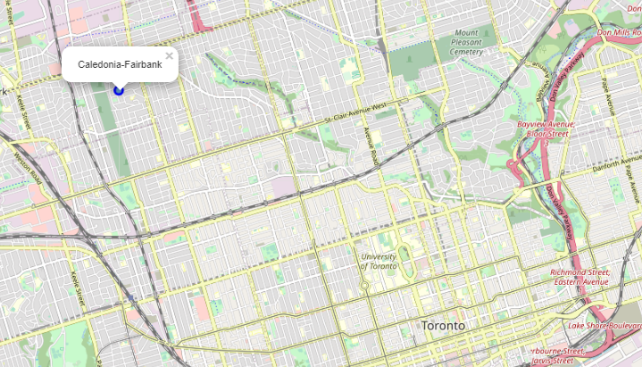
Results
Number of commercial businesses near target neighborhoods
Location of neighborhood that meets all the client’s requirements

Slide 10
Conclusion
I used crime data in Toronto and foursquare venue data to identify a neighborhood that meets all the client’s requirements to open a restaurant.
The analysis made in this project can be easily modified to satisfy requirements of another client to open a different business.

